Slide 1
EXAMINATION SYSTEM…
Guided By:- Prof. Subhasis Mohapatra
Presented by:
1.Satya Ranjan Patra | (2105274097)
2. Saswat Ranjan Mohanty | (2105274095)
3. Saroj Sabar | (2105274094)
4.Satya Ranjan Parida | (2105274098)

Slide 2
INTRODUCTION …
The Examination System project is a console application developed to manage and automate the process of conducting examinations. The system provides functionalities for creating and managing exam questions, allowing students to take exams, and generating result reports. It is designed to simplify the examination process, reduce administrative efforts, and provide accurate and efficient evaluation of student performance.

Slide 3
OBJECTIVES…
The main objectives of the Examination System project are as follows:
Develop a console application to facilitate the examination process.
Create and manage exam questionnaires.
Allow students to take exams instantly.
Automate the evaluation of exam answers and generate result reports.
Ensure data security and integrity.

Slide 4
TECHNOLOGY USED …
The Examination System project is developed using the following technologies:
Programming Language: Java
Database: MySQL
Database Connector: JDBC (Java Database Connectivity)
IDE :VS code

Slide 5
SYSTEM ARCHITECTURE…
The system architecture of the Examination System project follows a client-server model, where the client is the console application and the server is the MySQL database. The client interacts with the database using JDBC through the MySQL Connector. The database stores exam-related information such as questionnaires, student details, and exam results.

Slide 6
SYSTEM FEATURES…
Create Questionnaire: Allows the administrator to create a new questionnaire by providing the questionnaire title, total marks, and individual questions with options and correct answers.
Take Exam: Allows students to take exams by selecting the assigned questionnaire and providing answers to the questions.
Evaluate Exam: Automatically evaluates the exam answers submitted by students and generates a result report showing the obtained marks and percentage.
View Results: Provides the ability to view the exam results of all students .

Slide 7
DEVELOPMENT PROCESS…
The development of the Examination System project followed an iterative and incremental approach. The project was divided into the following phases:
Requirements Gathering: Gathered the functional and non-functional requirements of the project. Defined the desired features and user interactions.
Design: Designed the system architecture, database schema, and user interface. Developed class and database entity relationship diagrams to guide the implementation.
Coding:
Implementation: Implemented the application logic using Java and JDBC. Created the necessary classes and methods to create questionnaires, assign questionnaires, manage student details, take exams, and evaluate results.
Testing: Conducted thorough testing of the application to ensure correct functionality using manual testing.

Slide 8
FEASIBILITY STUDY …
• A feasibility study for a Examination system assesses the viability of implementing such a system in a Exam Automation system.
Technical Feasibility
Operational Feasibility
Schedule Feasibility:

Slide 9
SOFTWARE DEVELOPMENT LIFE CYCLE (SDLC) …
• Agile Model:-
Agile methodologies are well-suited for projects that require flexibility, frequent feedback, and the ability to adapt to changing requirements . Agile methodologies are well-suited for projects that require flexibility, frequent feedback, and the ability to adapt to changing requirements:
Iterative and Incremental Development:
Collaboration and Communication:
Prioritized Product Backlog:
Continuous Feedback and Adaptation:

Slide 10
DATABASE DESIGN…
The Examination System project utilizes a relational database to store and manage data related to exams. The database schema consists of the following tables:
Questions Table
Options Table
Students Table
Admin Table
Exam_results Table

Slide 11
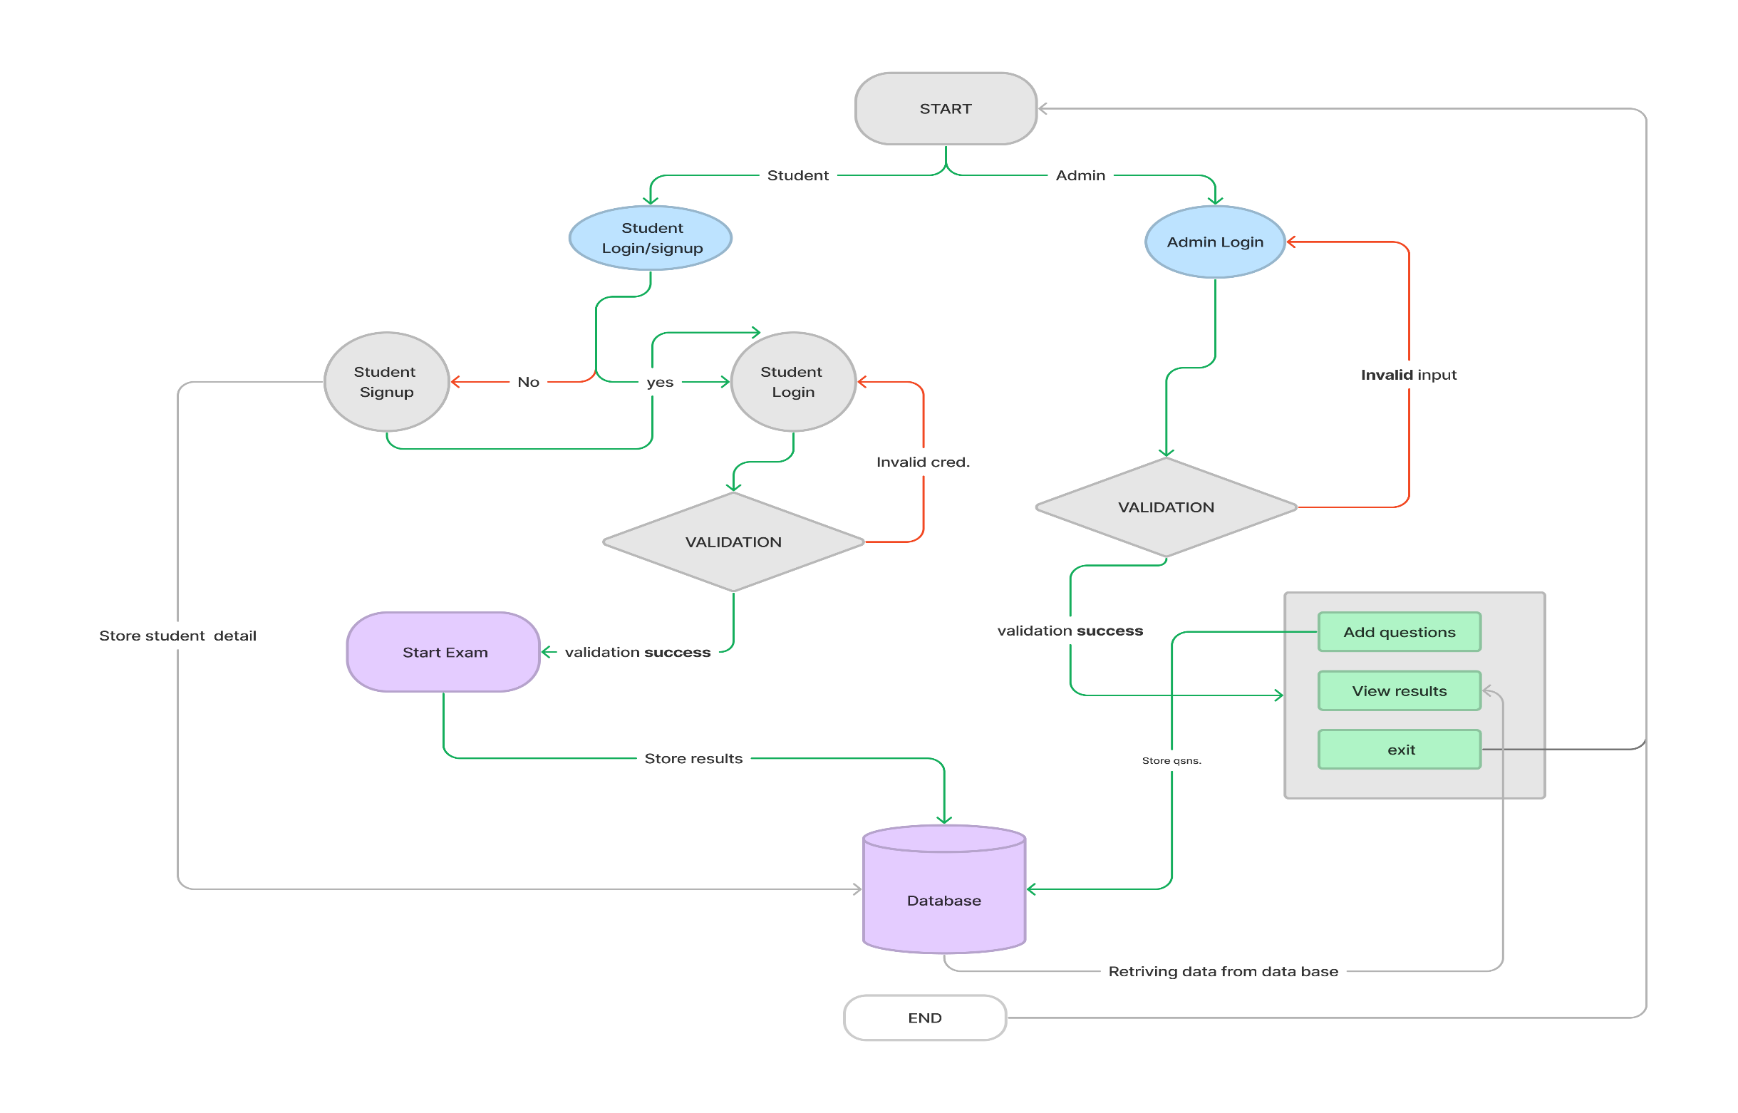
PROCESS-DIAGRAM…

Slide 12
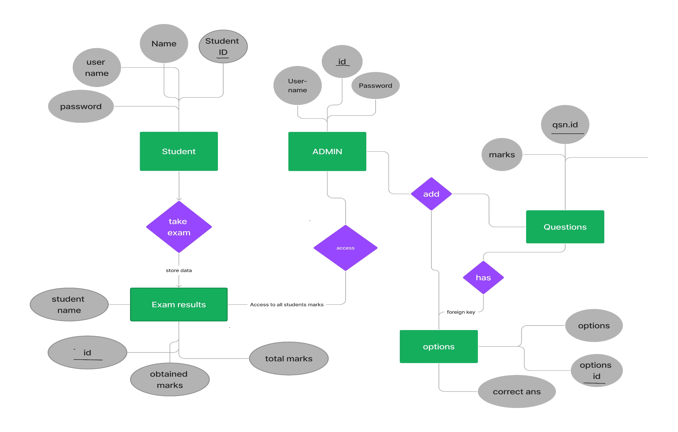
E-R DIAGRAM

Slide 13
Testing…
For the Examination System project, several types of testing can be applyed to ensure the quality and reliability of the software.
1. Manual Testing:
- This type of testing focuses on testing individual components or units of code.
2. System Testing:
- System testing involves testing the complete system as a whole.
- System testing verifies the system behavior, including the user interfaces, data flow, and system functionality.

Slide 14
HARDWARE & SOFTWARE REQUIREMENTS
HARDWARE REQUIREMENTS
SOFTWARE REQUIREMENTS
Processor:- Pentium IV or higher, (PIV-300GHz recommended)
Primary Memory:- 512 MB or More
HDD :- Min 1 GB hard free drive space
Operating System:- Win 7 or higher
Software:- Jdk 7 to 20.
Database:- MySQL,
Server:- MySQL

Slide 15
FUTURE ENHACEMENT…
Although the current version of the Examination System project provides the core functionalities, there are several possible enhancements for future iterations:
Question Bank Management: Develop a feature to manage a pool of questions and allow random selection of questions for each questionnaire.
Prevent multiple attempt.
Add student feed back.
Fixing bugs.
Improved User Interface: Develop a graphical user interface (GUI) for a more user-friendly experience

Slide 16
CONCLUSION…
The Examination System project has successfully achieved its objectives of automating the examination process through a console application. The application provides a user-friendly interface for administrators and students to manage and participate in exams efficiently. With future enhancements and iterative improvements, the system can be further expanded to cater to the evolving needs of educational institutions and streamline the examination process.

Slide 17
THANK YOU…

